Slide 1



THE POWER OF WILO’s CREATIVE COLLABORATIONS
HOW TO COLLABORATE & INNOVATE IN A WORLD OF CHANGE & UNCERTAINTY?
KARIM MUSTAGHNI
CO-FOUNDER

Slide 2
AGENDA
PART A: CURIOSITY
PART B: CREATIVITY
PART C: COLLABORATION
      CULTURE
      DIVERSITY
      CREATIVE COLLABORATION EXAMPLES

Slide 3


CURIOSITY
PART A
-

Slide 4


CURIOSITY
PART A
-

Slide 5



CURIOSITY
PART A
Age 2/3-6

Slide 6



CURIOSITY
PART A
-

Slide 7

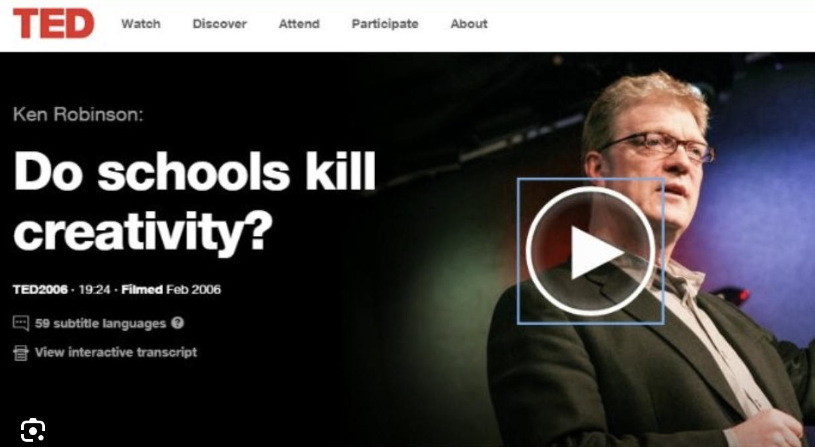
CURIOSITY
PART A
-
„Progressive schools“ / 21st-century skills“
„Focus less on specific knowledge, rather focus on abstract skills like ‚creativity, problem-solving, curiosity“

Slide 8
CURIOSITY
PART A
„Curiosity drives knowledge, as much as knowledge drives curiosity.“
The more we know, the easier we learn, the more we enjoy learning.
e.g. James Black

Slide 9




CURIOSITY
Knowledge Icebergs
PART A
Broad
Curiosity
Narrow
Curiosity
-

Slide 10

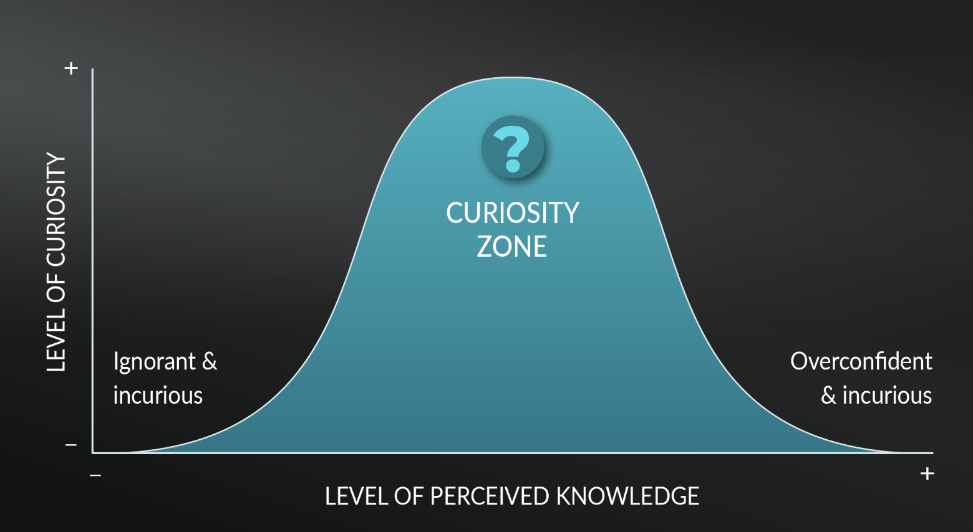


CURIOSITY
PART A
-

Slide 11

CURIOSITY
PART A
LEARNINGS
Long-term memory is key to build database for curiosity.
Experiencing narrow curiosity and/or broad curiosity can be a privilege.
Curiosity drives knowledge as much as knowledge drives curiosity.
-

Slide 12

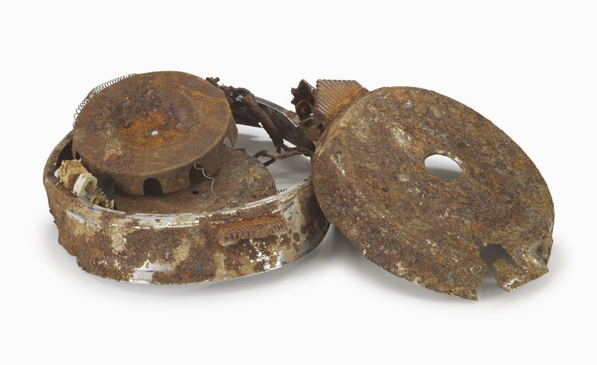
CREATIVITY
PART B
Bill Bowerman

Slide 13

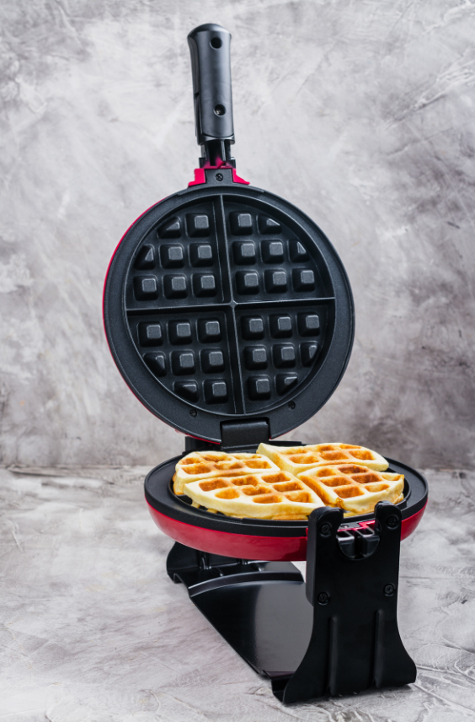

CREATIVITY
PART B
-

Slide 14


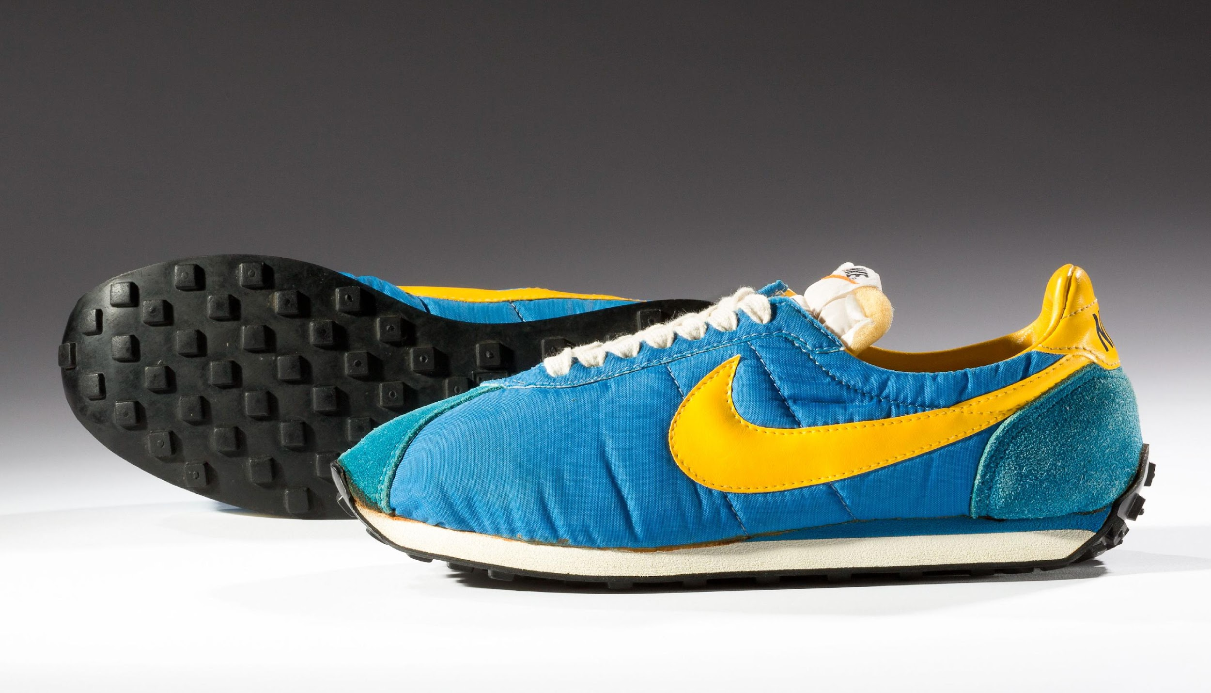
CREATIVITY
PART B
Narrow Curiosity meets
Broad Curiosity

Slide 15

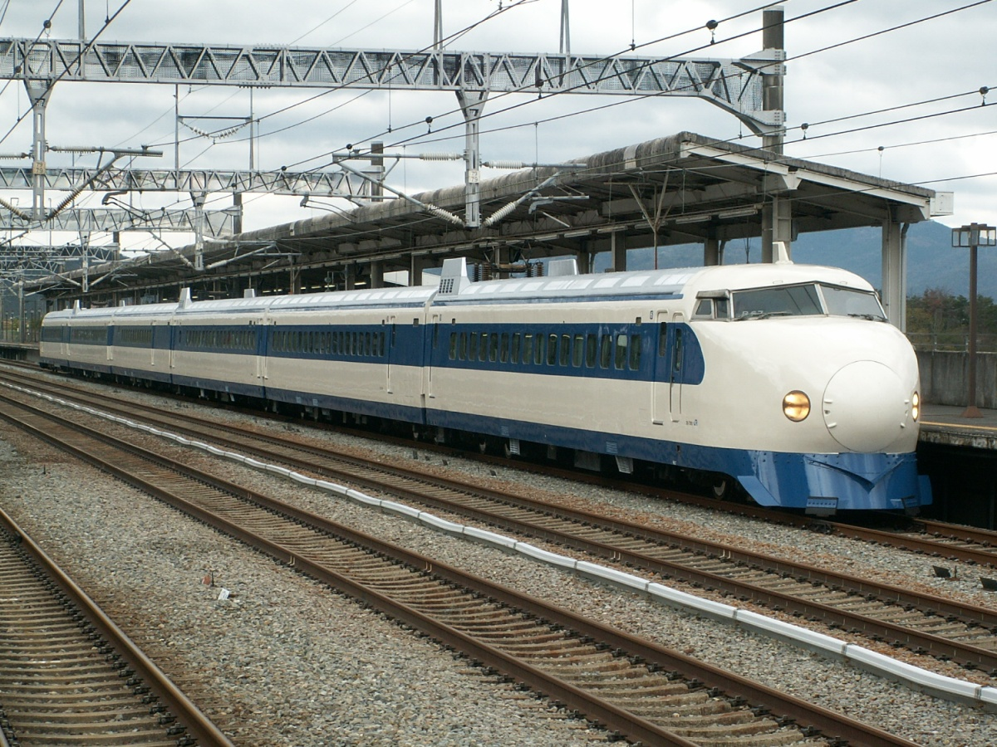
CREATIVITY
PART B
-

Slide 16

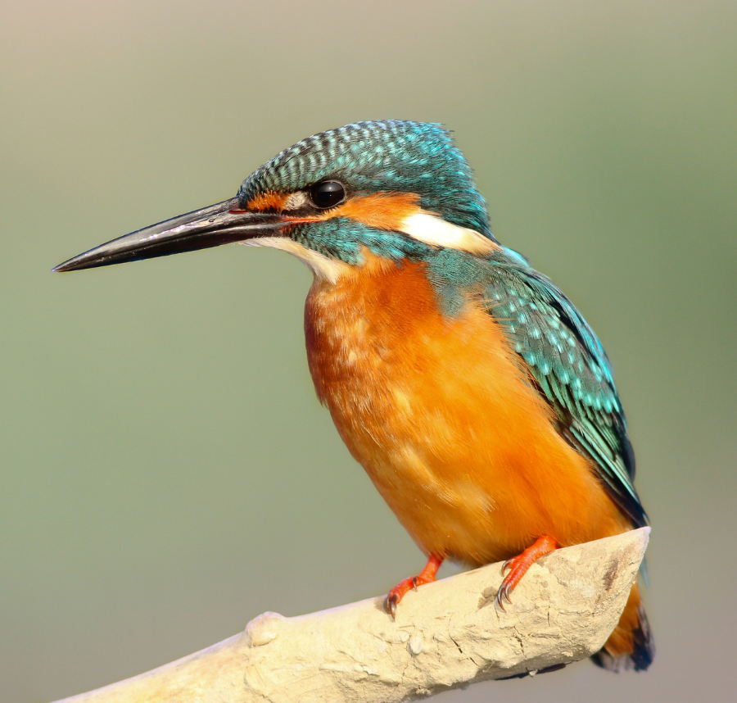
CREATIVITY
PART B
-

Slide 17

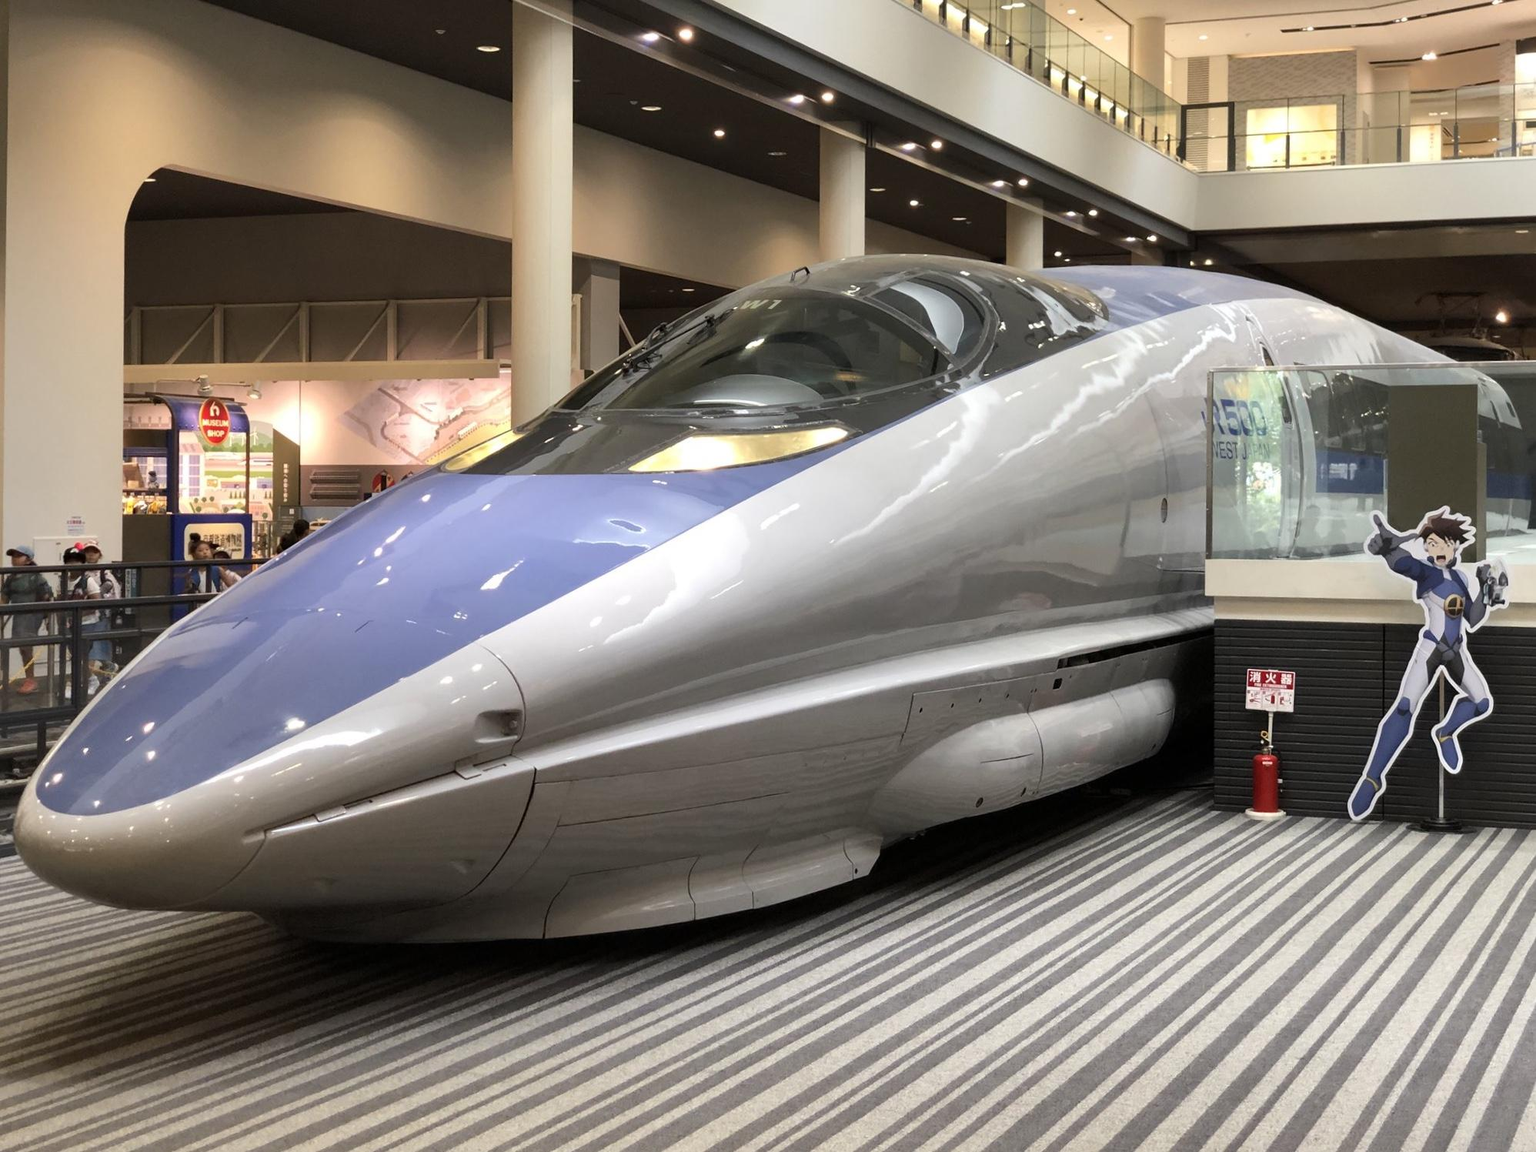
CREATIVITY
PART B
Narrow Curiosity meets
Narrow Curiosity

Slide 18

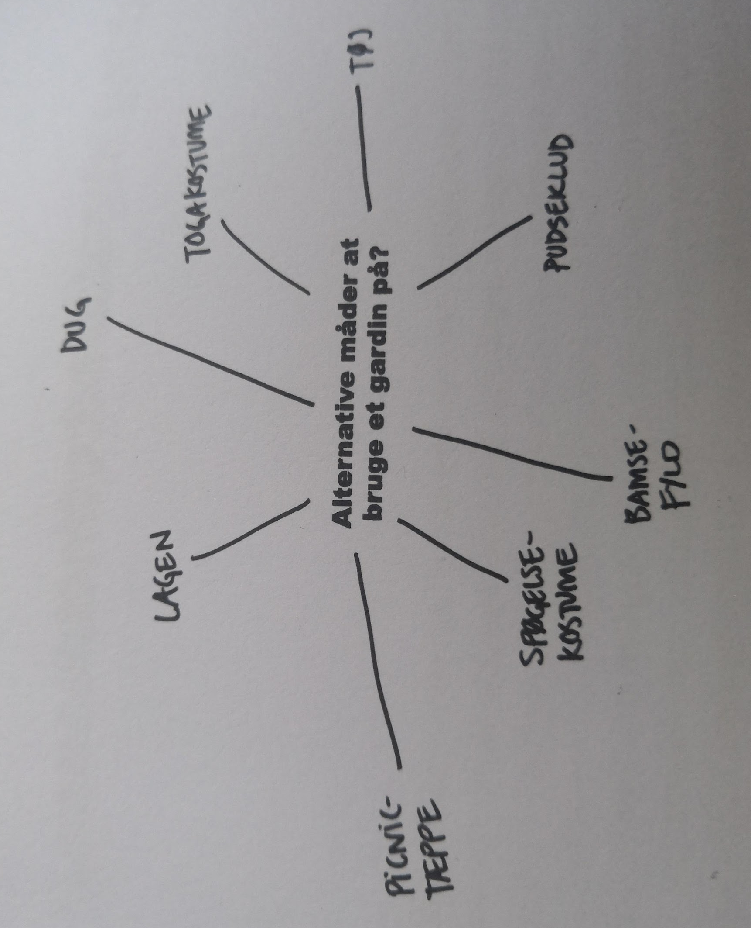
CREATIVITY
PART B
-
What else can you
do with a XYZ ?

Slide 19

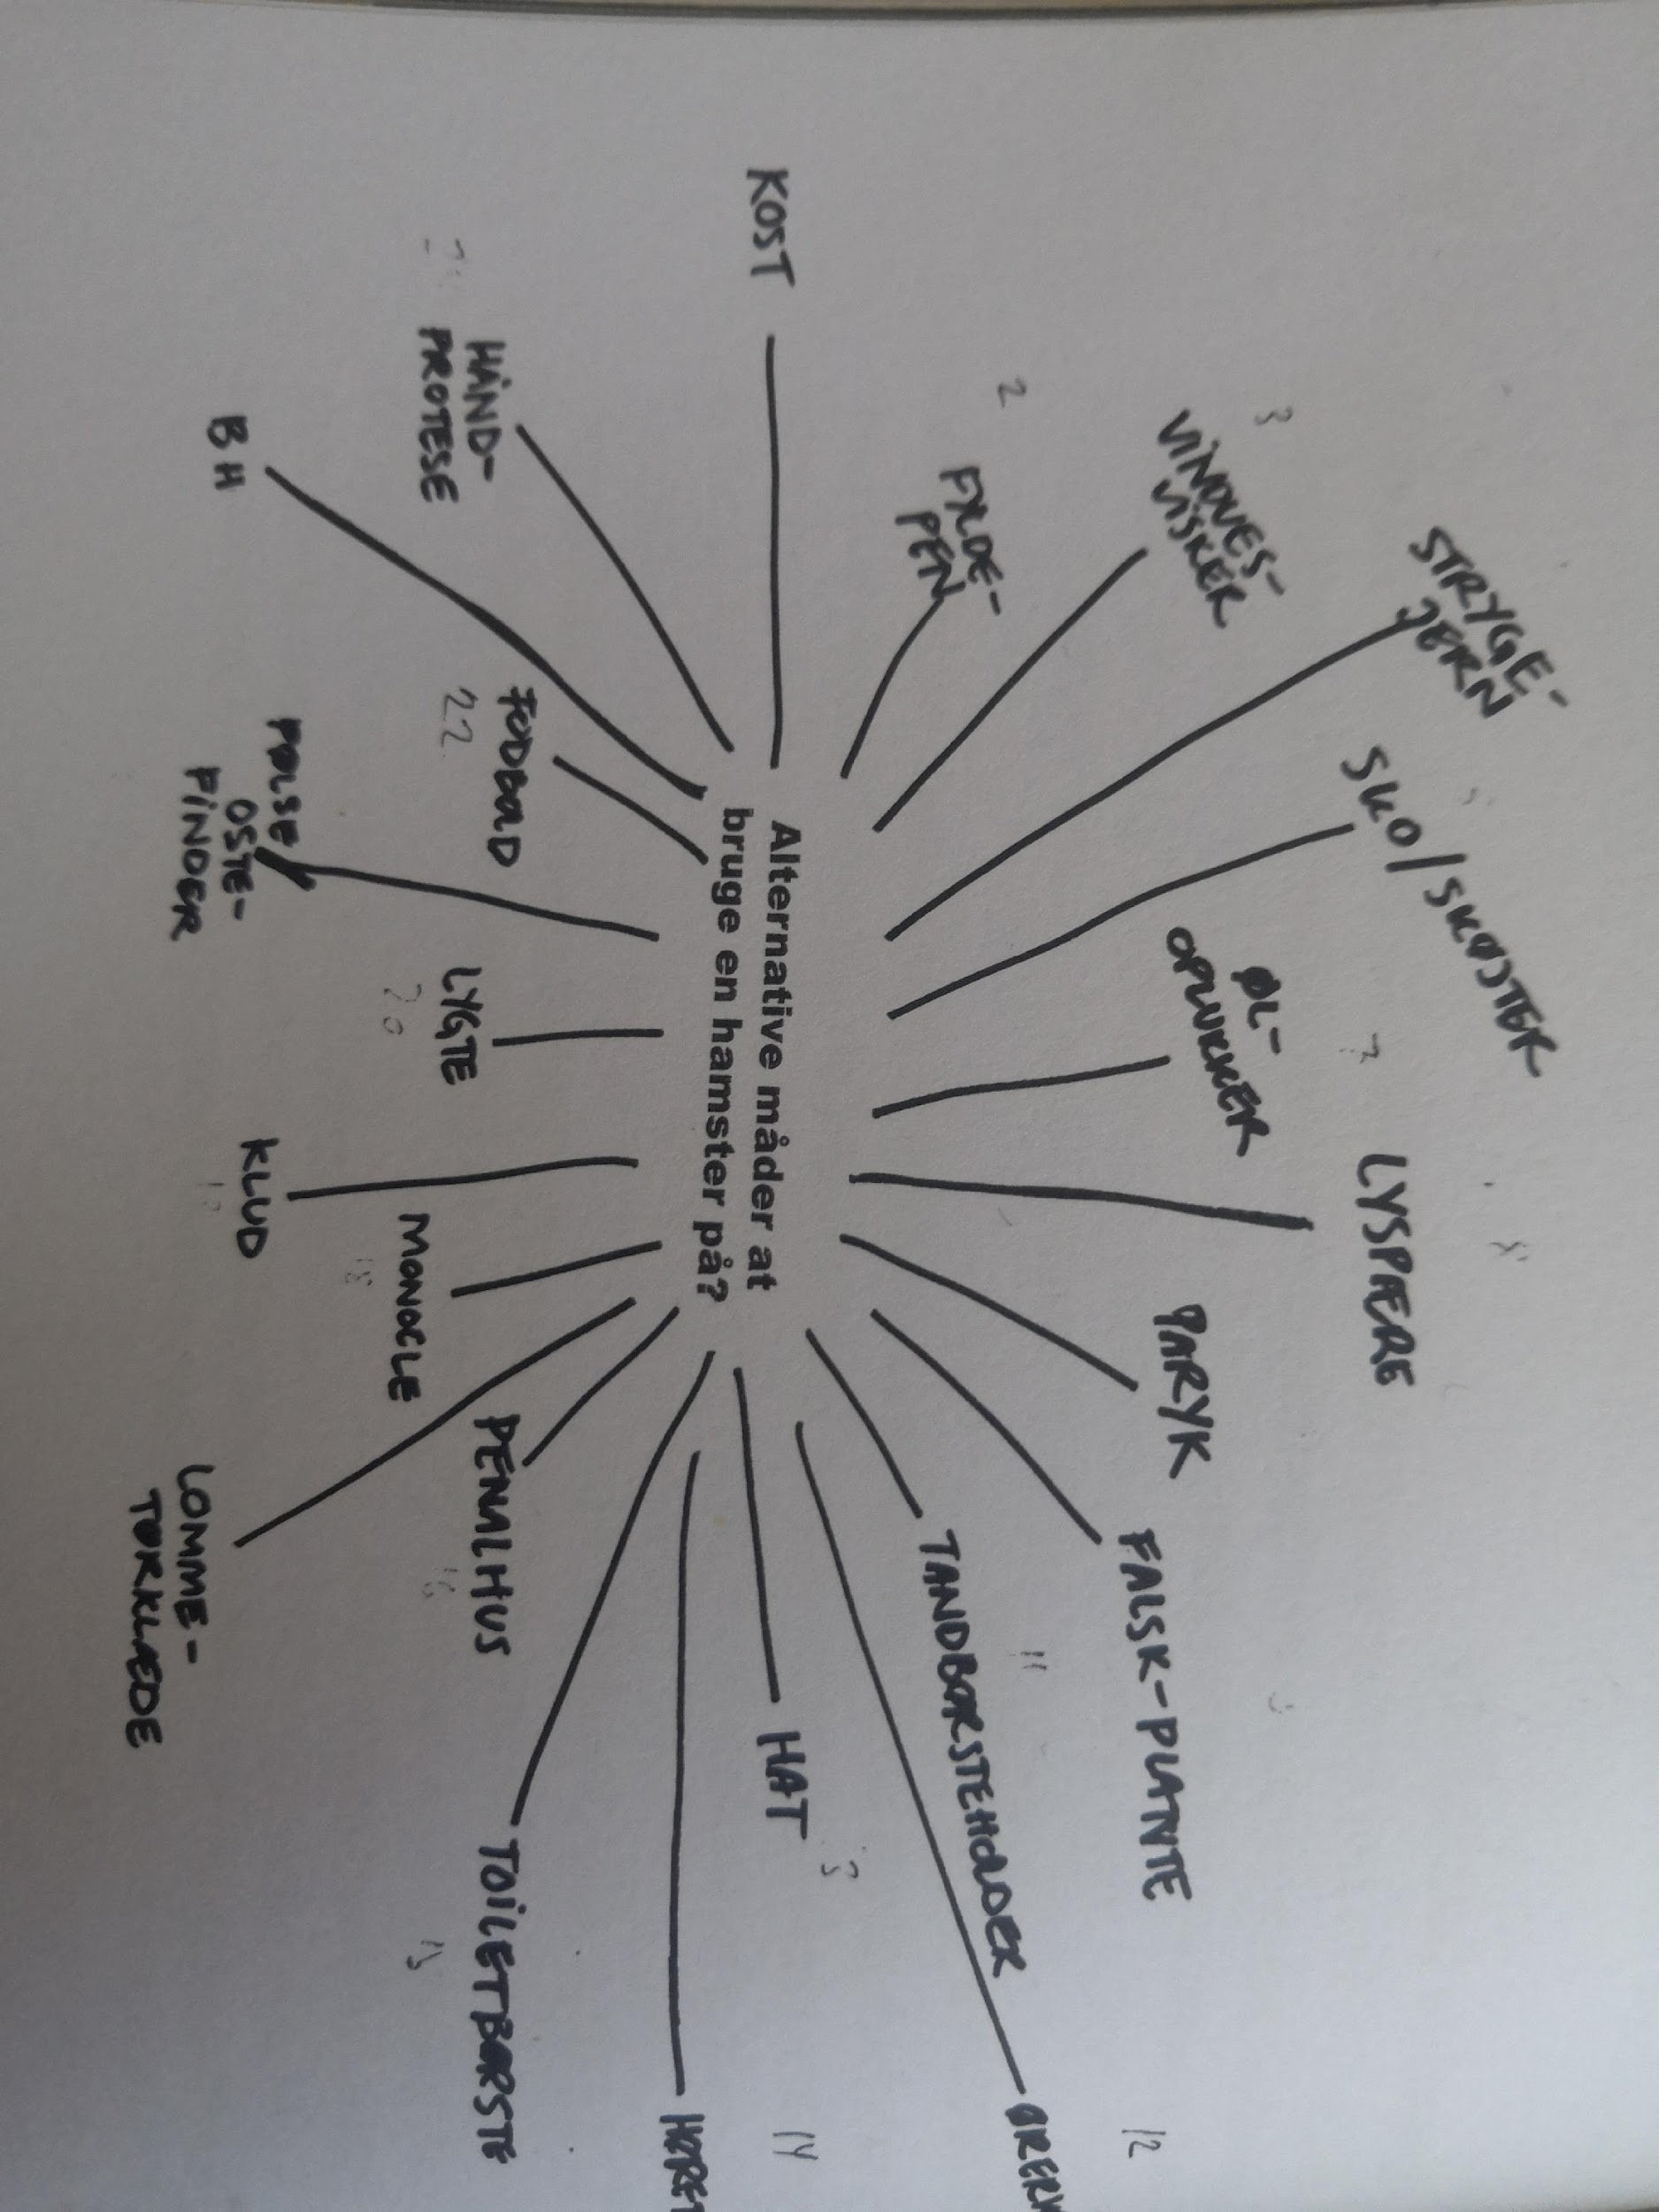
CREATIVITY
PART B
-
What else can you
do with a XYZ ?

Slide 20

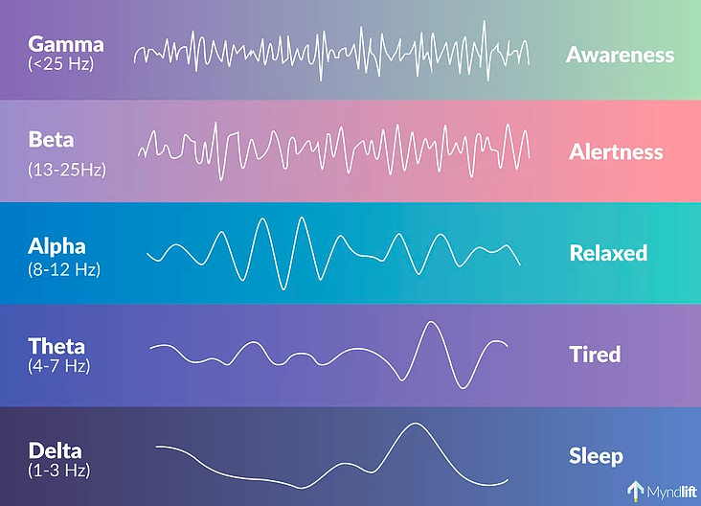
CREATIVITY
PART B
1. LEARNING
PEOPLE WHO ARE HIGHLY CREATIVE,
A. ARE GOOD AT SEEING CONNECTIONS &
B. HAVE A HIGHER LEVEL OF ALPHA BRAINWAVE ACTIVITY, WHEN CREATIVELY ACTIVE.
-

Slide 21
CREATIVITY
PART B
2. LEARNING
BY MAKING CONNECTIONS CONSCIOUSLY,
THE BRAIN STARTS MAKING CONNECTIONS UNCONSCIOUSLY
-

Slide 22

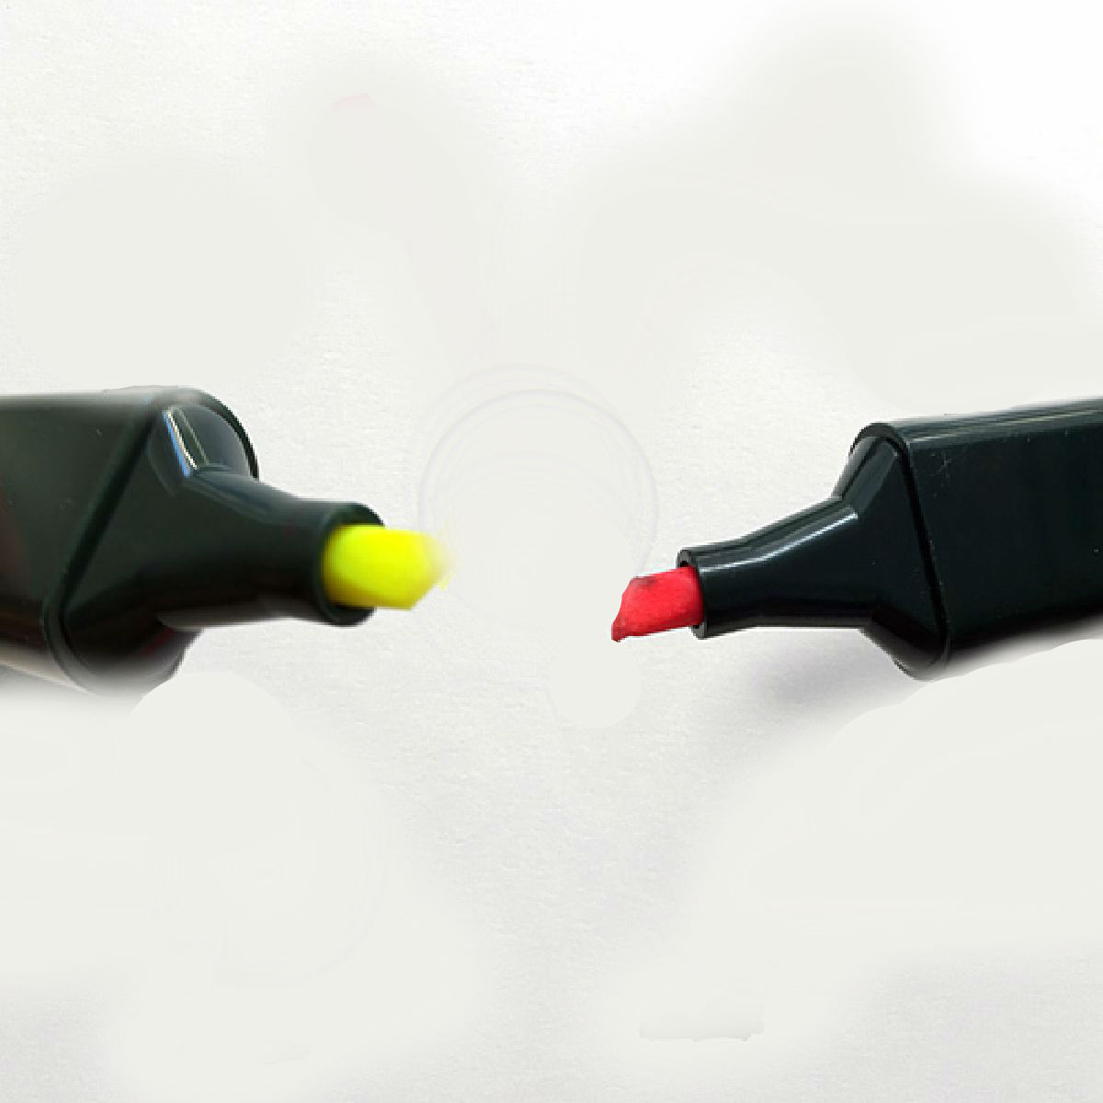
CREATIVITY
PART B
-
* Copyright by Christoph Niemann

Slide 23

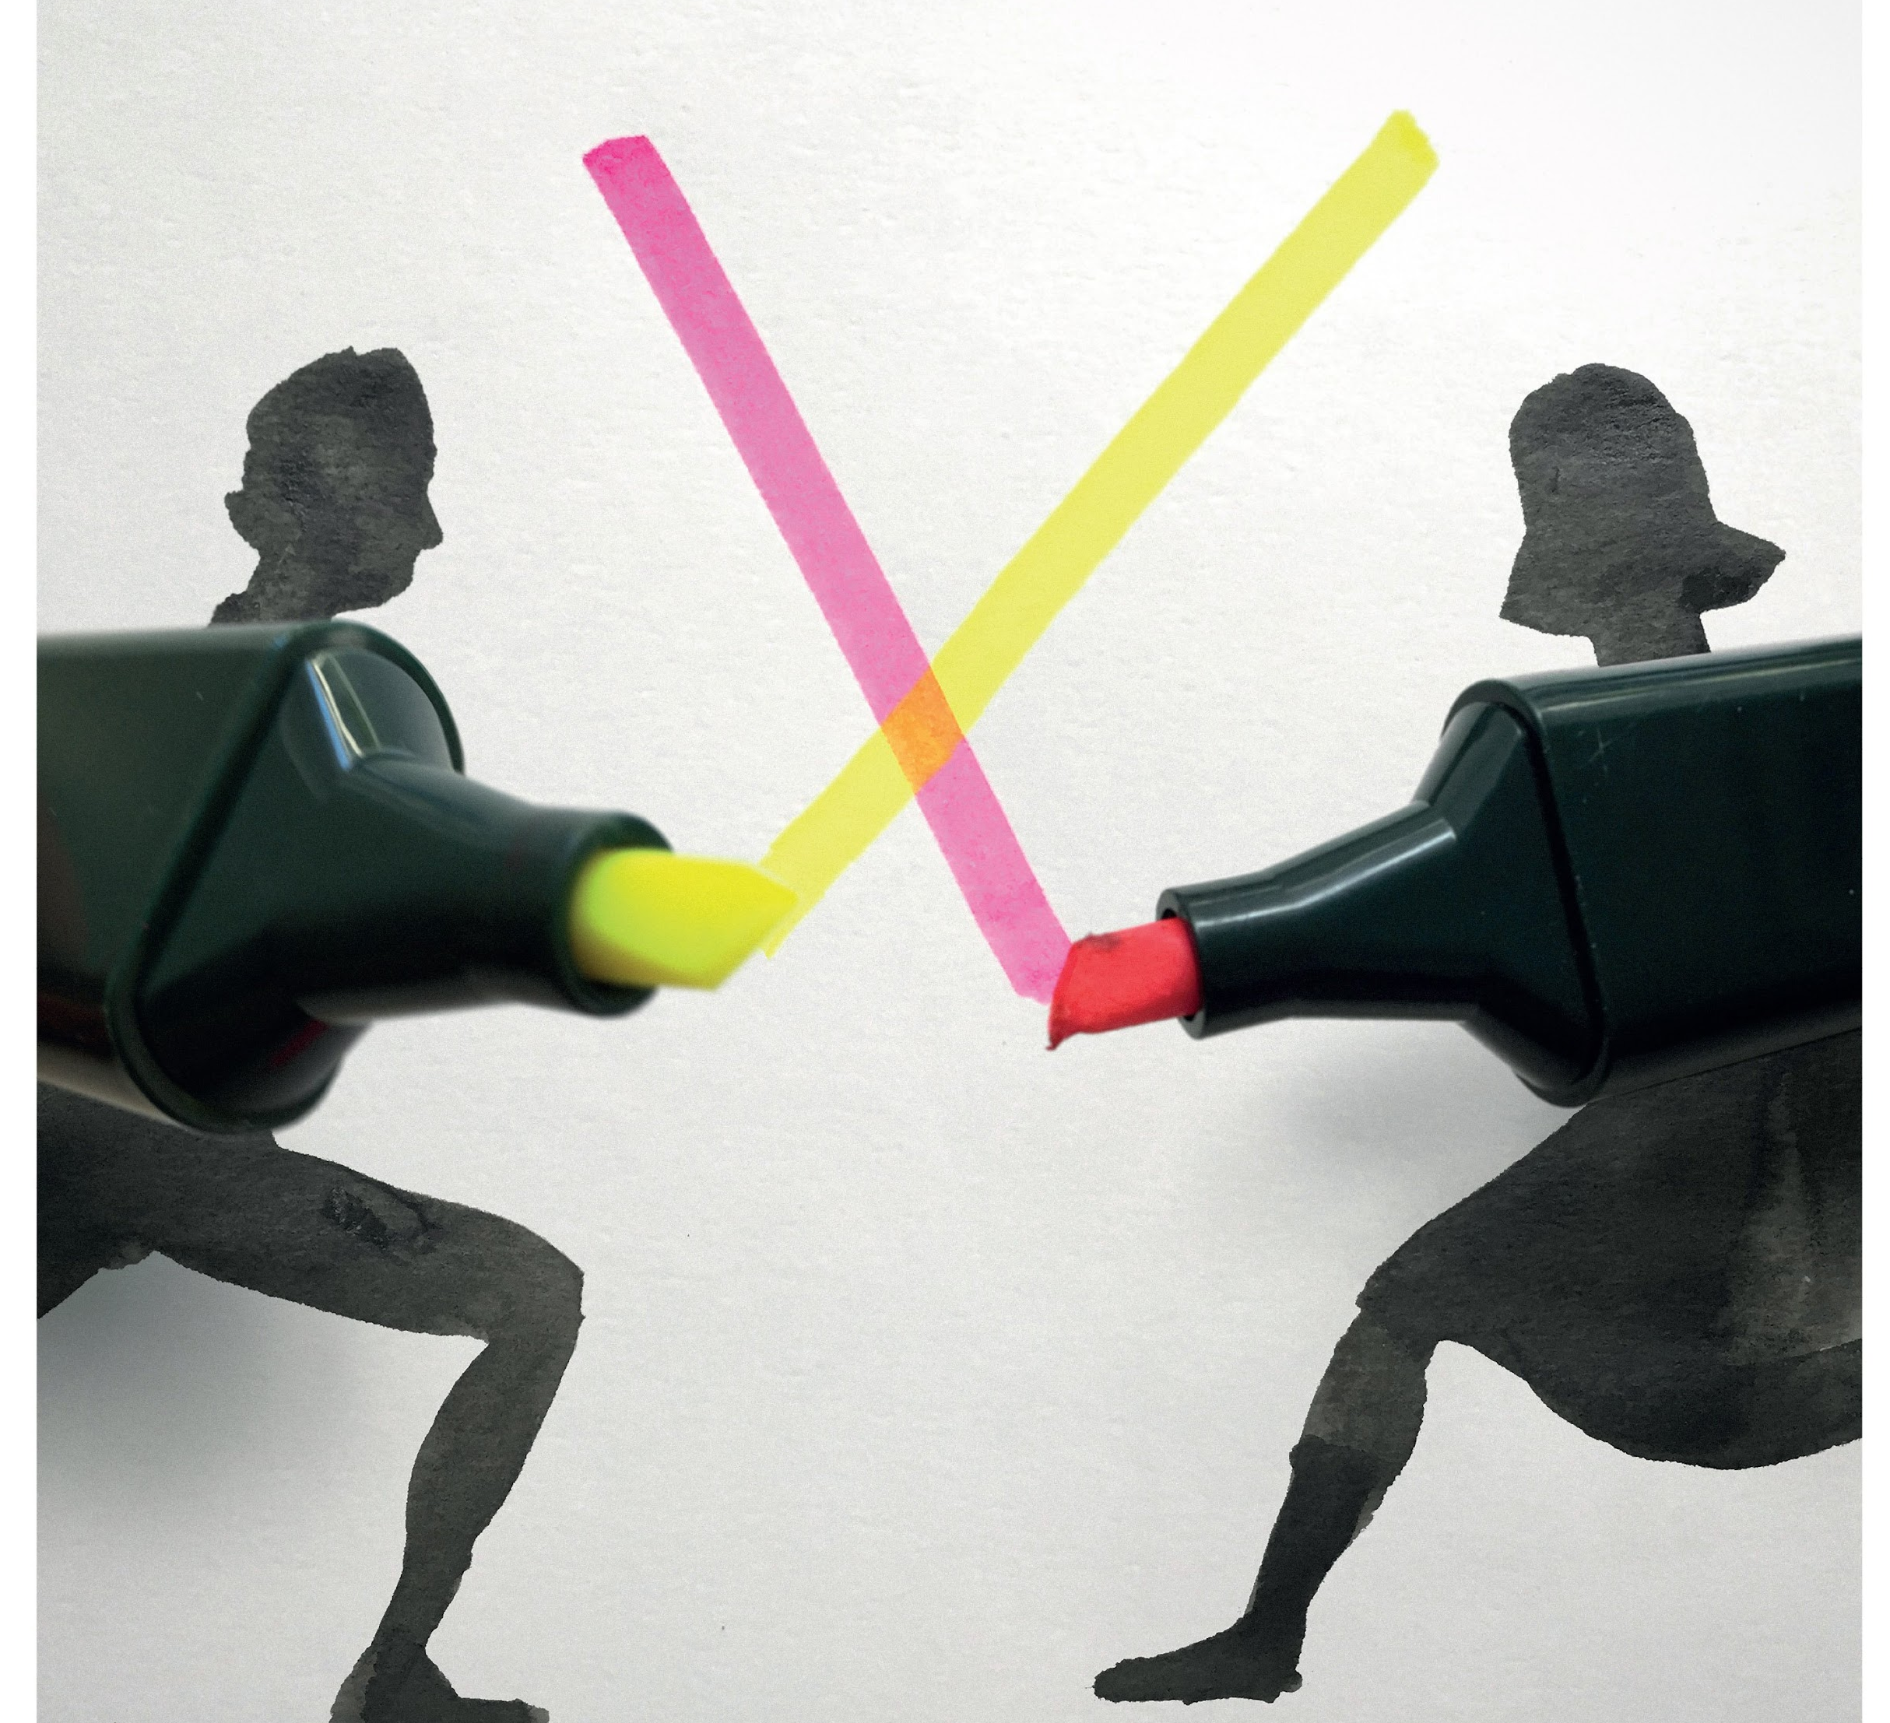
CREATIVITY
PART B
-
* Copyright by Christoph Niemann

Slide 24
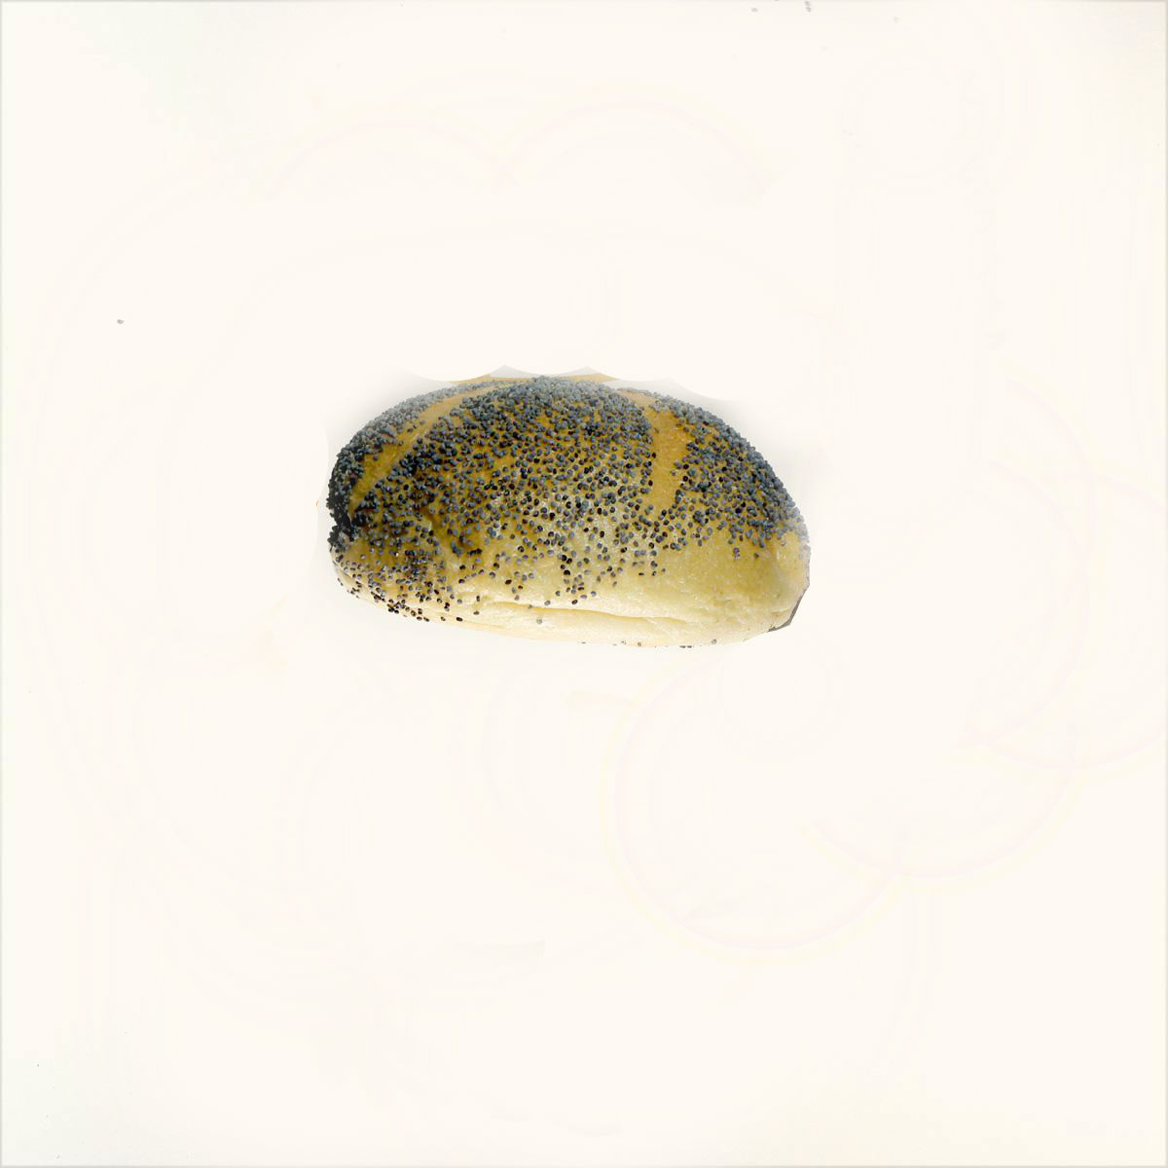
CREATIVITY
PART B
-
* Copyright by Christoph Niemann

Slide 25


CREATIVITY
PART B
-
* Copyright by Christoph Niemann

Slide 26


CREATIVITY
PART B
-
* Copyright by Christoph Niemann

Slide 27


CREATIVITY
PART B
-
* Copyright by Christoph Niemann

Slide 28

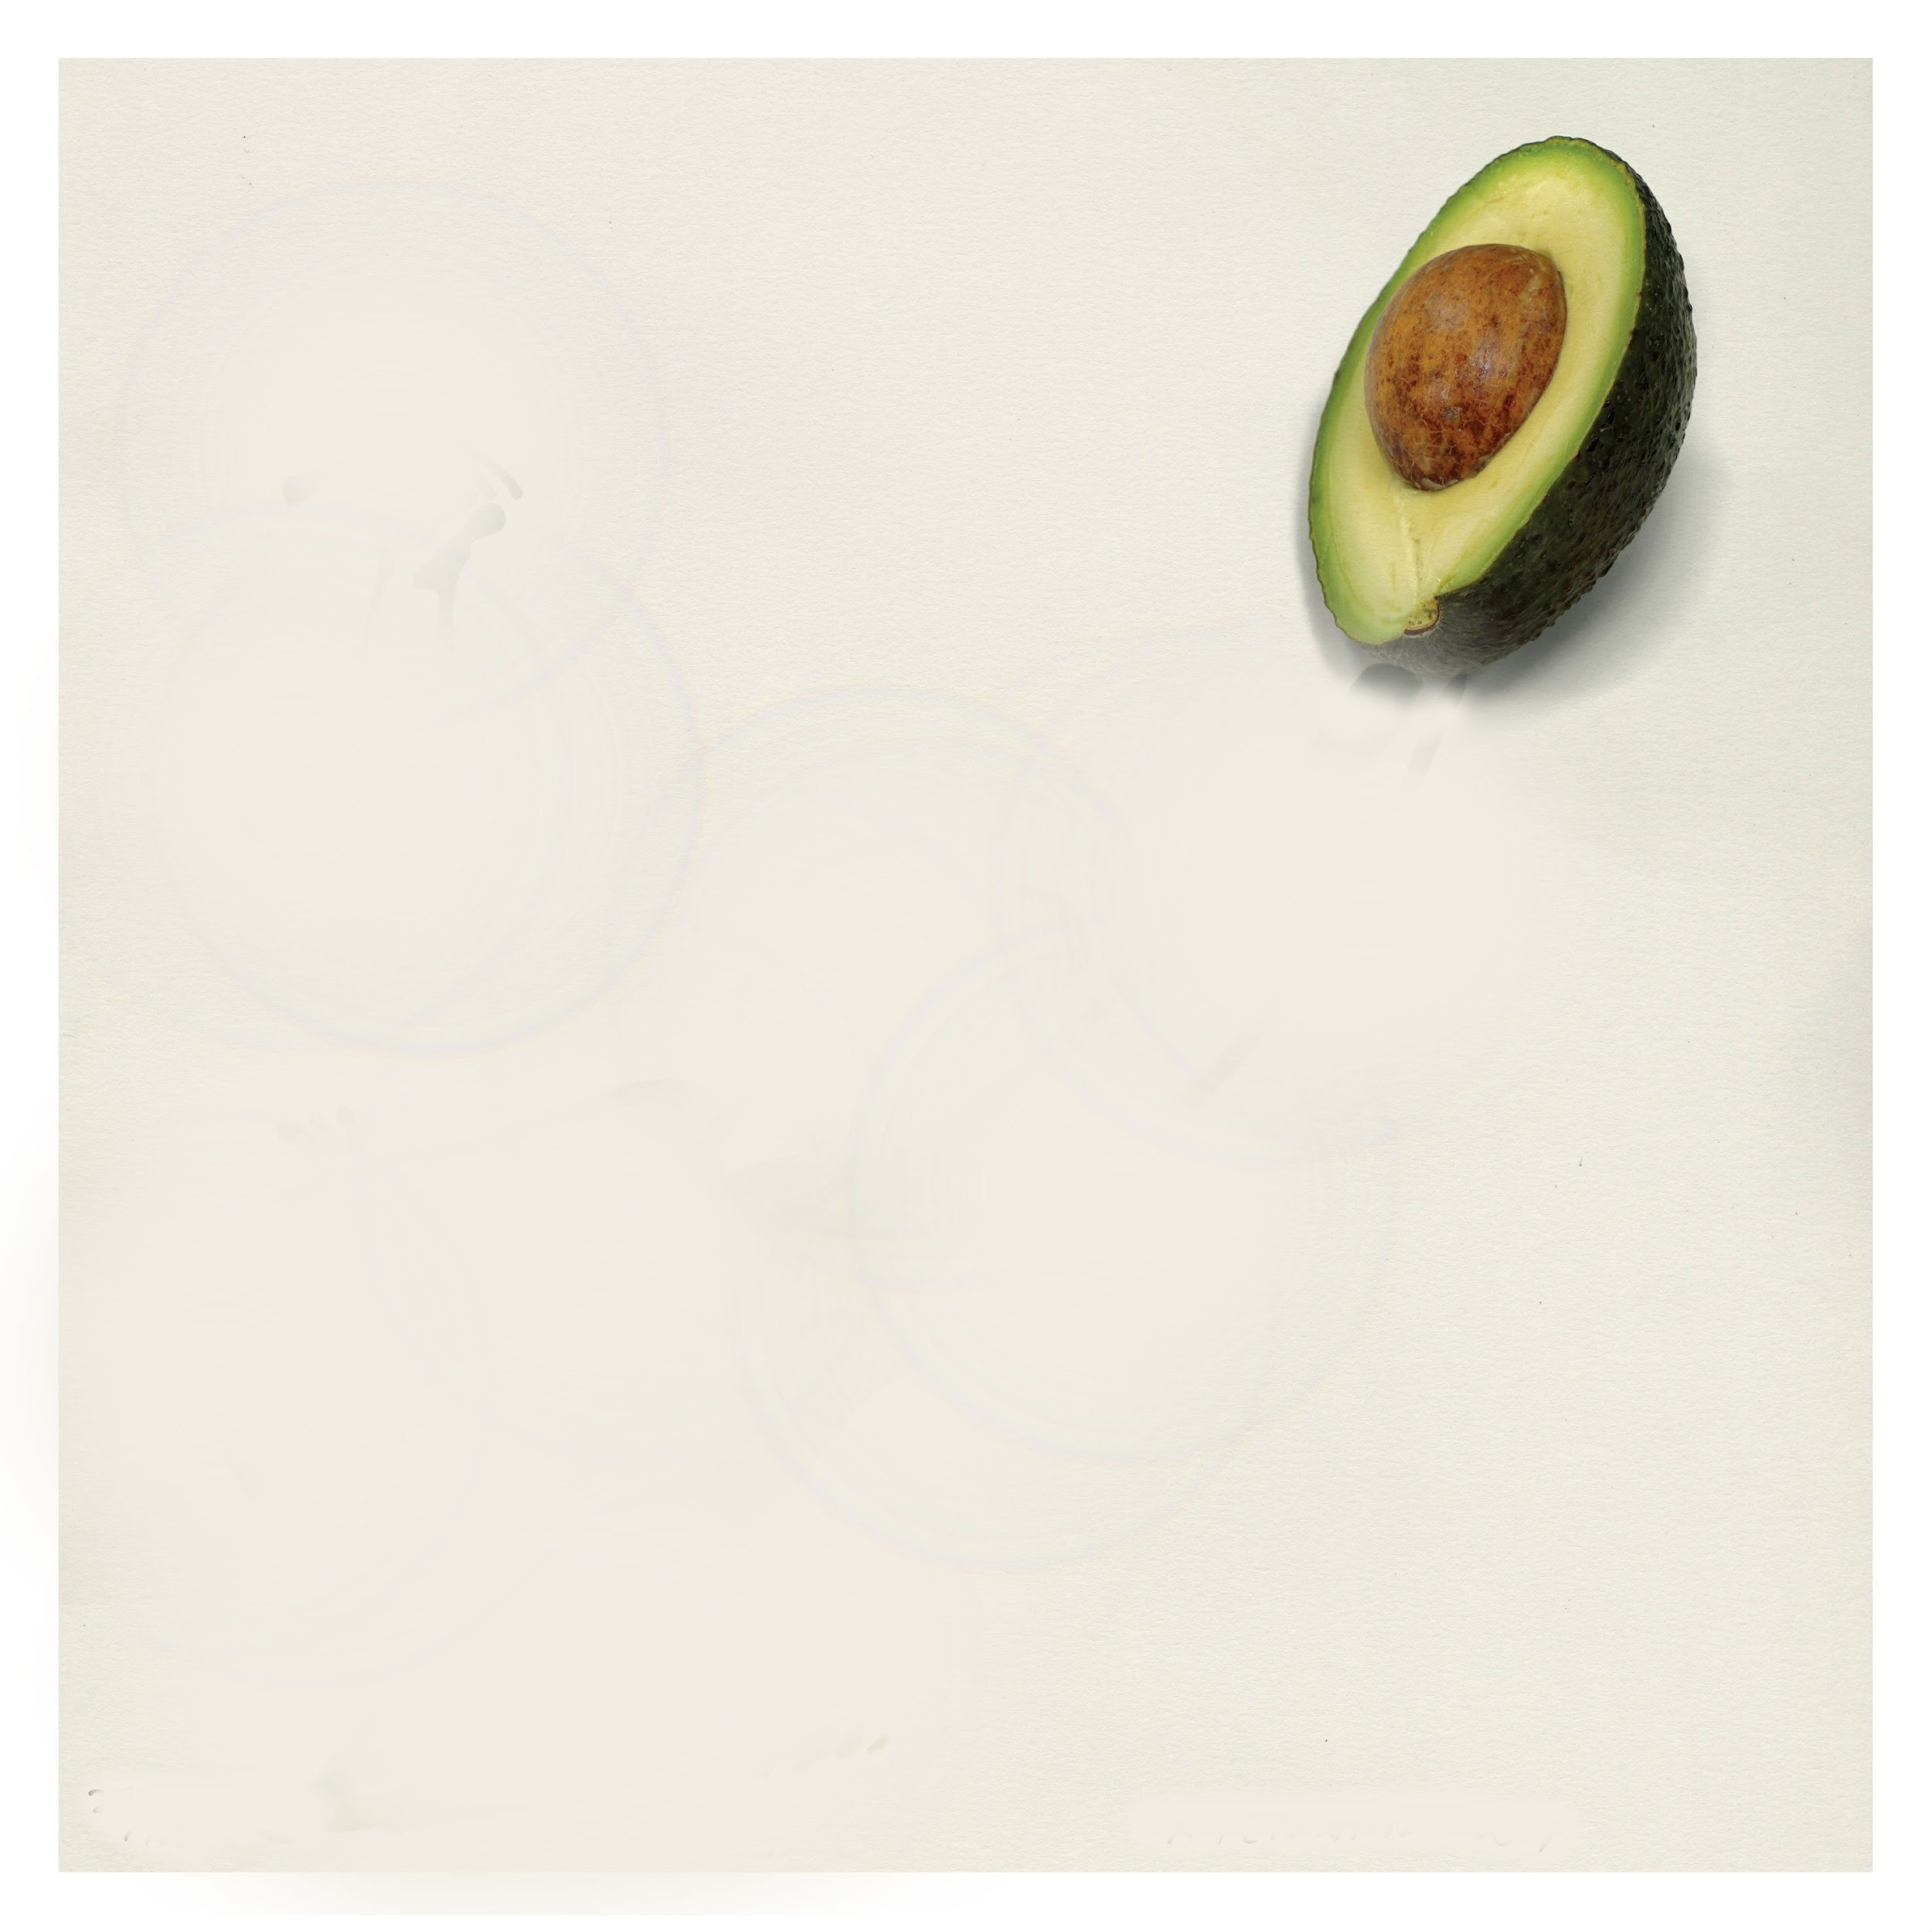
CREATIVITY
PART B
-
* Copyright by Christoph Niemann

Slide 29

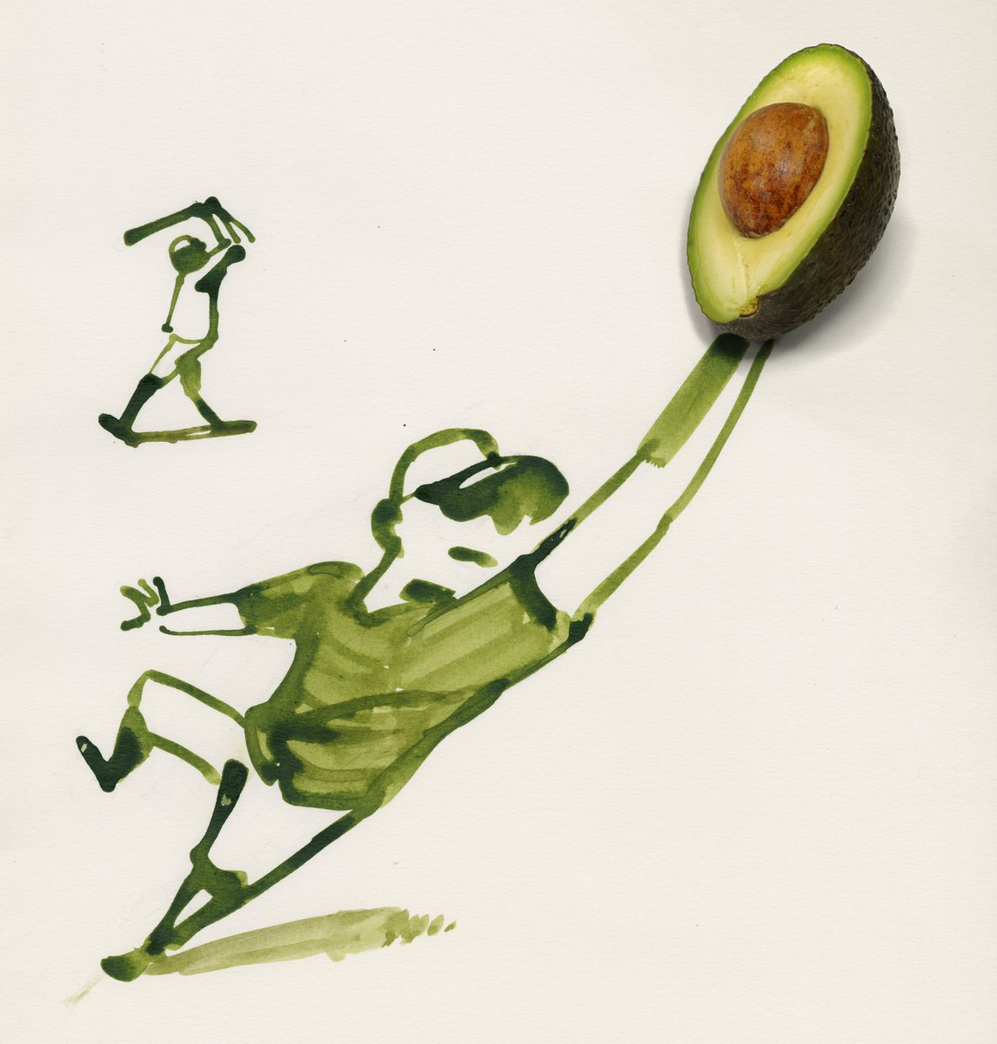
CREATIVITY
PART B
-
* Copyright by Christoph Niemann

Slide 30

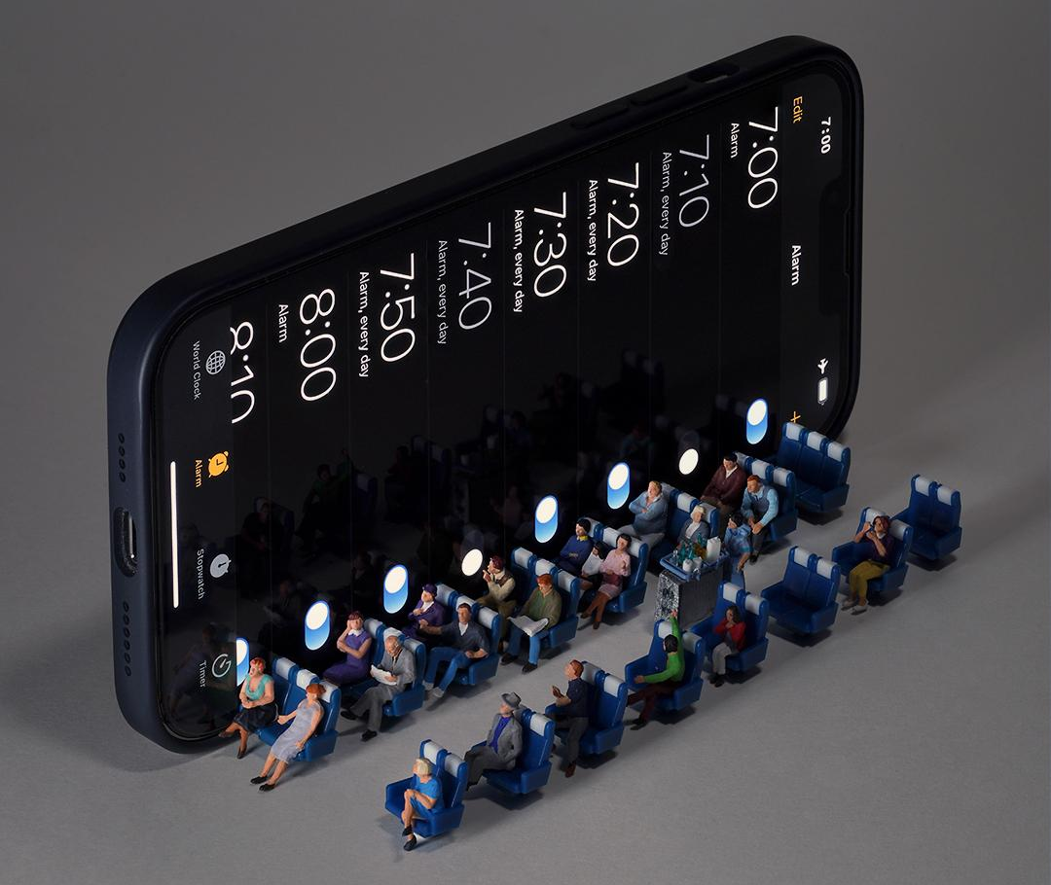
CREATIVITY
PART B
-
* Copyright by Tatsuya Tanaka

Slide 31

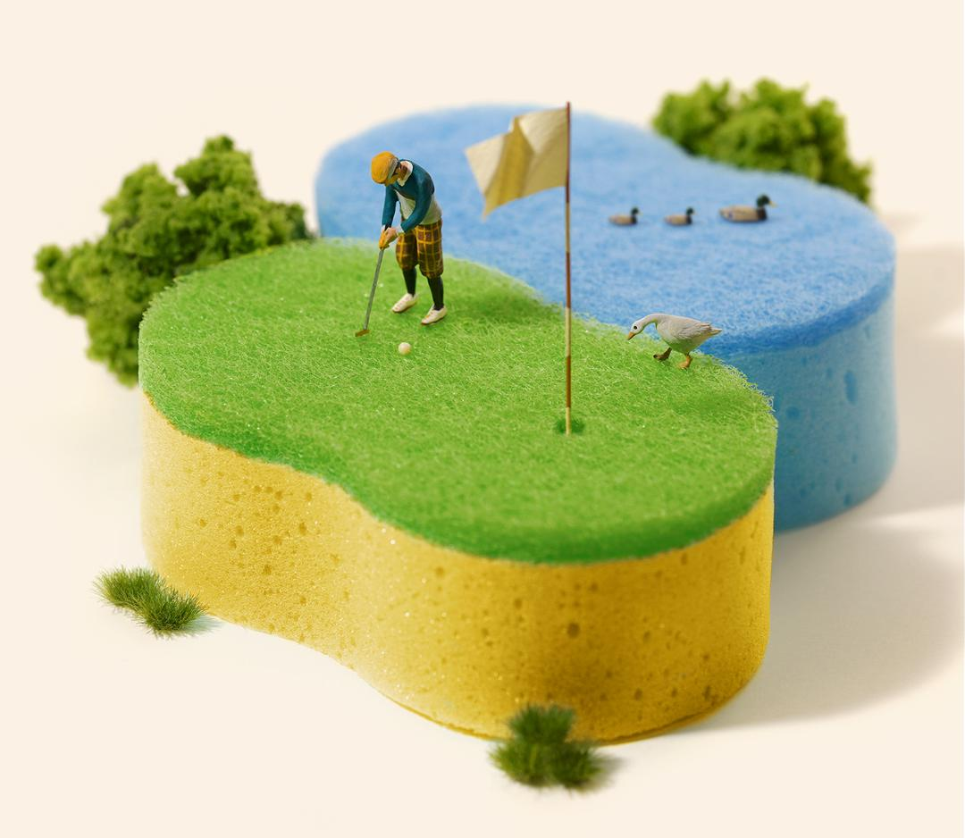
CREATIVITY
CREATIVITY
PART B
-
* Copyright by Tatsuya Tanaka

Slide 32

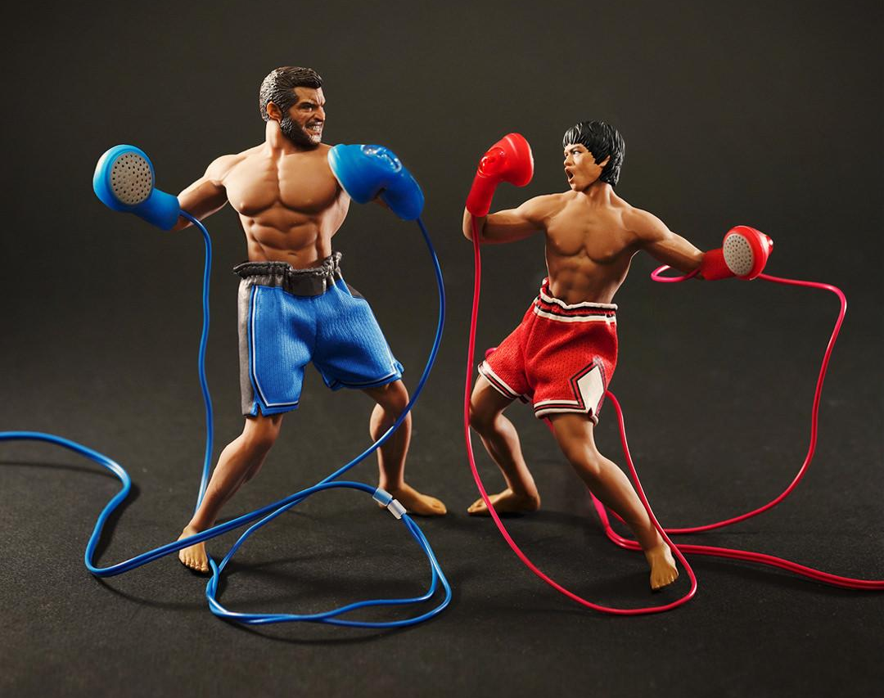
CREATIVITY
PART B
-
* Copyright by Tatsuya Tanaka

Slide 33


CREATIVITY
PART B
-
SEND IT TO ME!
KARIMMUSTAGHNI.COM
KARIM@CULTUREDESIGN.ORG

Slide 34



Slide 35



Slide 36



Slide 37
COLLABORATIONS
PART C
ARE YOU IN CREATION OR SURVIVAL MODE?
In which mode are you?
1. CULTURE

Slide 38
COLLABORATIONS
PART C
IN AVERAGE WE SPEND 70% OF OUR DAILY TIME IN SURVIVAL MODE
Survival Mode
1. CULTURE

Slide 39
COLLABORATIONS
PART C
Survival Mode: Emotions
Anger, Aggression, Hostility, Hatred, Comparison, Fear, Anxiety, Worry, Pain, Suffering, Guilt, Shame, Unworthiness, Envy, Jealousy, etc.
1. CULTURE

Slide 40
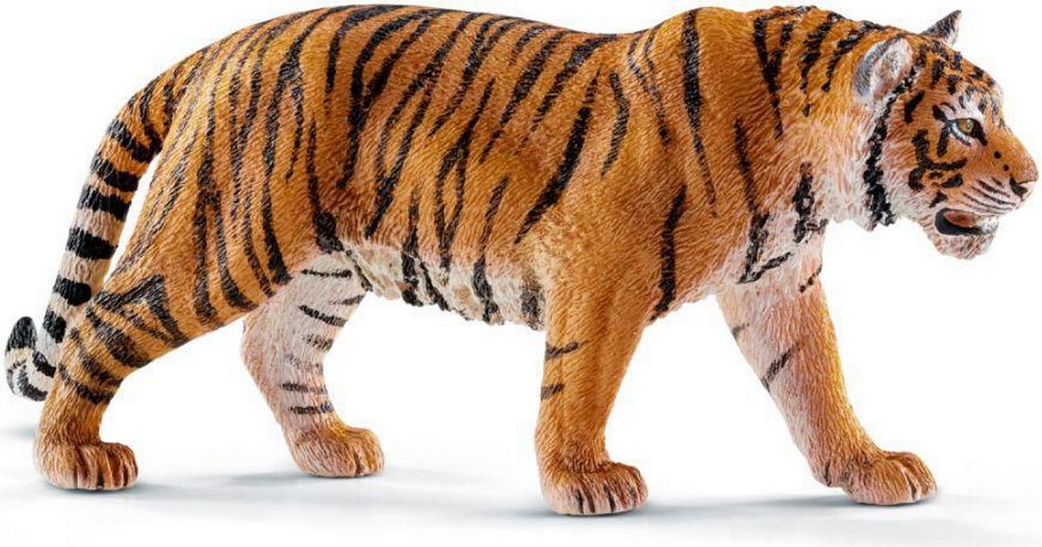


COLLABORATIONS
Your brain thinks there is a ‚tiger‘ in the room. ->
1. fight, freeze or flight
2. narrow focus
3. Thought-emotion loop
PART C
Survival Mode: Body/Mind
1. CULTURE

Slide 41
COLLABORATIONS
PART C
Creation Mode
Grateful, thankful, inspired, curious, joyful, confident, etc.
1. CULTURE

Slide 42


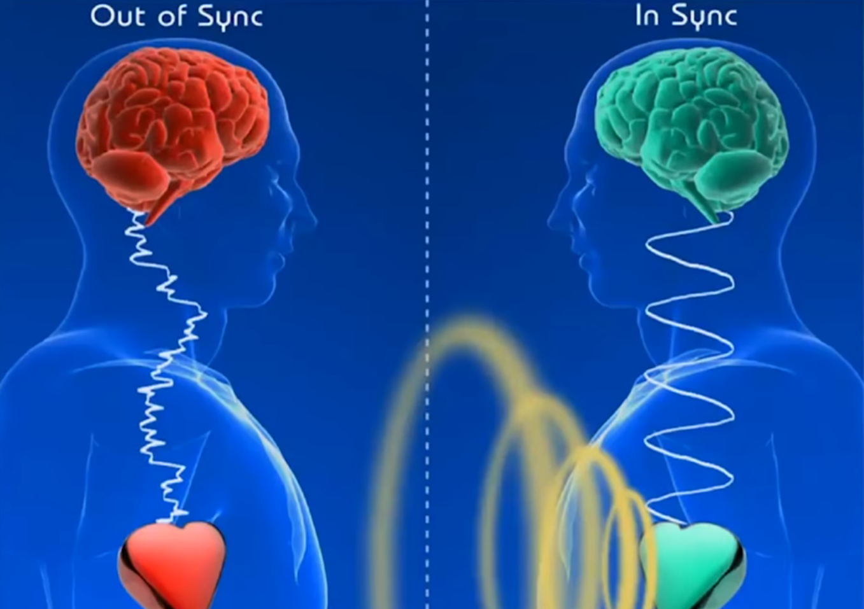
COLLABORATIONS
PART C
1. LEARNING
To be in creation mode, you need:
Brain-Heart coherence
Brain-Heart Coherence
1. CULTURE

Slide 43

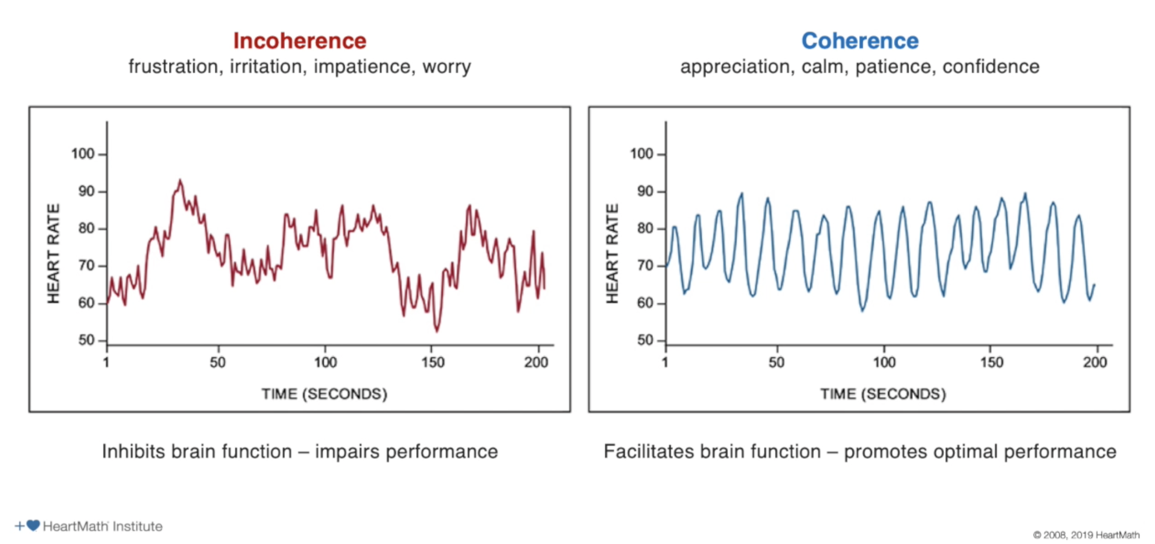

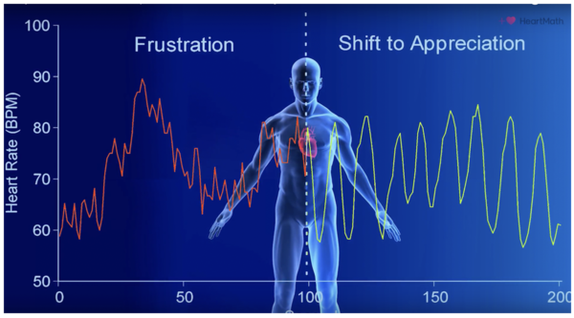
COLLABORATIONS
PART C
1A. LEARNING
Survival
Creation
Brain-Heart Coherence -> Heart
PRACTICE GRATITUDE / WRITE & FEEL
1. CULTURE

Slide 44

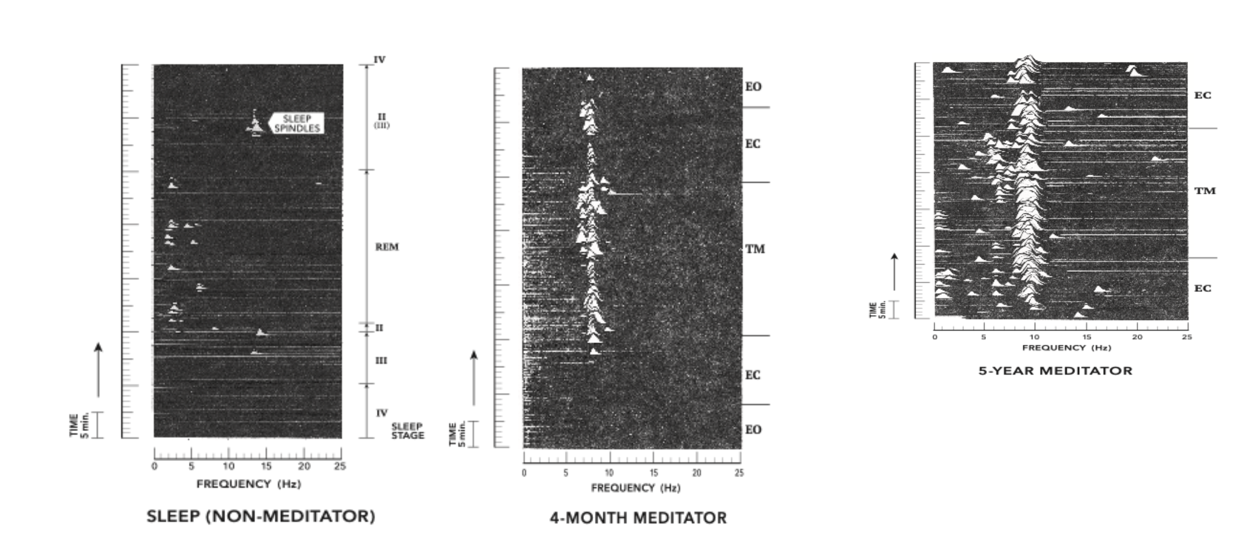
COLLABORATIONS
PART C
1B. LEARNING
Brain-Heart Coherence -> Brain
PRACTICE MEDITATION
1. CULTURE

Slide 45

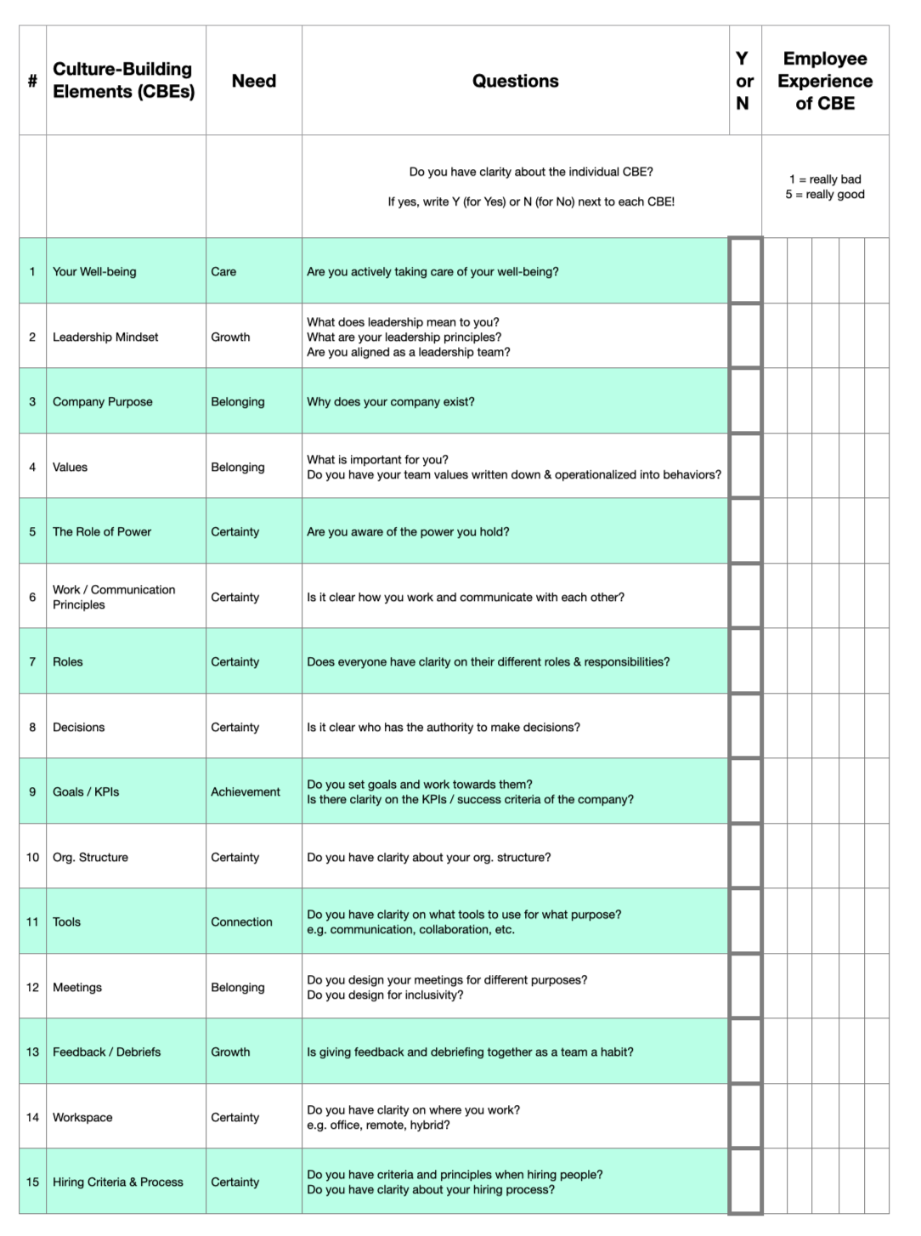
COLLABORATIONS
2. LEARNING
COHERENCE
PART C
CLARITY
Brain-Heart Coherence -> Brain
THROUGH THE CULTURE-BUILDING ELEMENTS (CBEs)
1. CULTURE

Slide 46
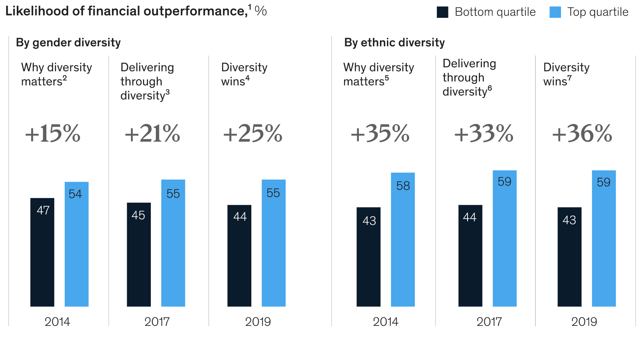
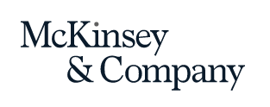
COLLABORATIONS
PART C
These findings emerge from McKinsey’s largest data set so far,
encompassing 15 countries and more than 1,000 large companies.
Opinion Diversity
2. DIVERSITY
Source: https://www.mckinsey.com/featured-insights/diversity-and-inclusion/diversity-wins-how-inclusion-matters

Slide 47
COLLABORATIONS
PART C
-
2. DIVERSITY

Slide 48
COLLABORATIONS
PART C
8809 = 6 | 5555 = 0
7111 = 0 | 8193 = 3
2172 = 0 | 8096 = 5
6666 = 4 | 1012 = 1
1111 = 0 | 7777 = 0
3213 = 0 | 9999 = 4
7662 = 2 | 7756 = 1
9313 = 1 | 6855 = 3
0000 = 4 | 5881 = 4
2222 = 0 | 5531 = 0
3333 = 0 | 2581 = ???
-
2. DIVERSITY

Slide 49





COLLABORATIONS
PART C
-
LAUNCHED 3000+ STARTUPS LIKE:
2. DIVERSITY

Slide 50
COLLABORATIONS
LEARNING
PART C
CULTURAL DIVERSE PEOPLE HAVE A HIGH ‚CREATIVE RESOURCE AVAILABILITY‘ IF
1. PRACTICED WELL &
2. IF THE CULTURE SUPPORTS IT
-
2. DIVERSITY

Slide 51
LITTLE WAKE-UP EXERCISE
9 DOTS PROBLEM / 3 MIN
E
—> Connect the dots with no more than 4 straight lines without lifting your hand from the paper.
* 9 dots problem, Sam Loyd, Cyclopedia of Puzzles. (The Lamb Publishing Company, 1914)

Slide 52
LITTLE WAKE-UP EXERCISE
9 DOTS PROBLEM
E
* 9 dots problem, Sam Loyd, Cyclopedia of Puzzles. (The Lamb Publishing Company, 1914)

Slide 53
LITTLE WAKE-UP EXERCISE
9 DOTS PROBLEM
E
* 9 dots problem, Sam Loyd, Cyclopedia of Puzzles. (The Lamb Publishing Company, 1914)

Slide 54
LITTLE WAKE-UP EXERCISE
9 DOTS PROBLEM
E
* 9 dots problem, Sam Loyd, Cyclopedia of Puzzles. (The Lamb Publishing Company, 1914)

Slide 55
LITTLE WAKE-UP EXERCISE
9 DOTS PROBLEM
E
* 9 dots problem, Sam Loyd, Cyclopedia of Puzzles. (The Lamb Publishing Company, 1914)

Slide 56

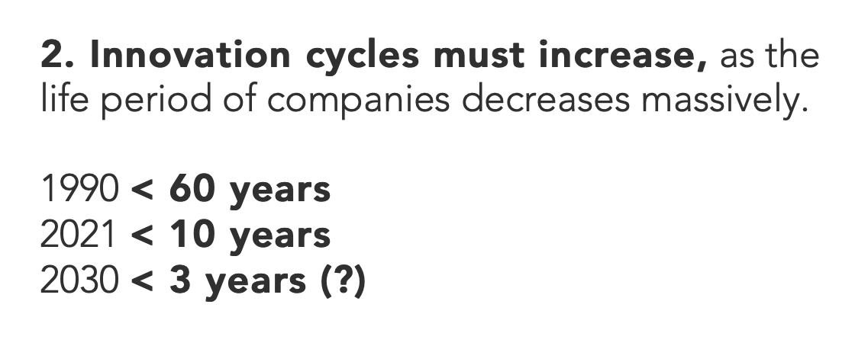
COLLABORATIONS
PART C
-
3. CREATIVE COLLABORATION
EXAMPLES

Slide 57
COLLABORATIONS
PART C
1. Companies that collaborate well are 30% more innovative and 36% more productive.*
2. In 2017, American Express reported that mid-size companies gained a profit of 1.4 times their investment through a collaboration.
-
3. CREATIVE COLLABORATION
EXAMPLES
* Deloitte Study

Slide 58

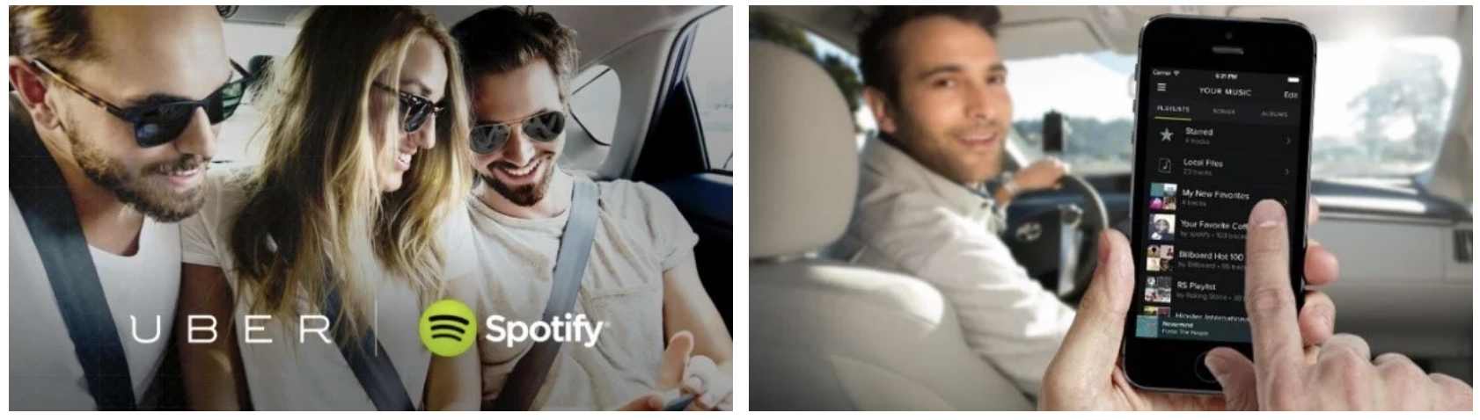
COLLABORATIONS
PART C
-
3. CREATIVE COLLABORATION
EXAMPLES

Slide 59


COLLABORATIONS
PART C
-
3. CREATIVE COLLABORATION
EXAMPLES

Slide 60

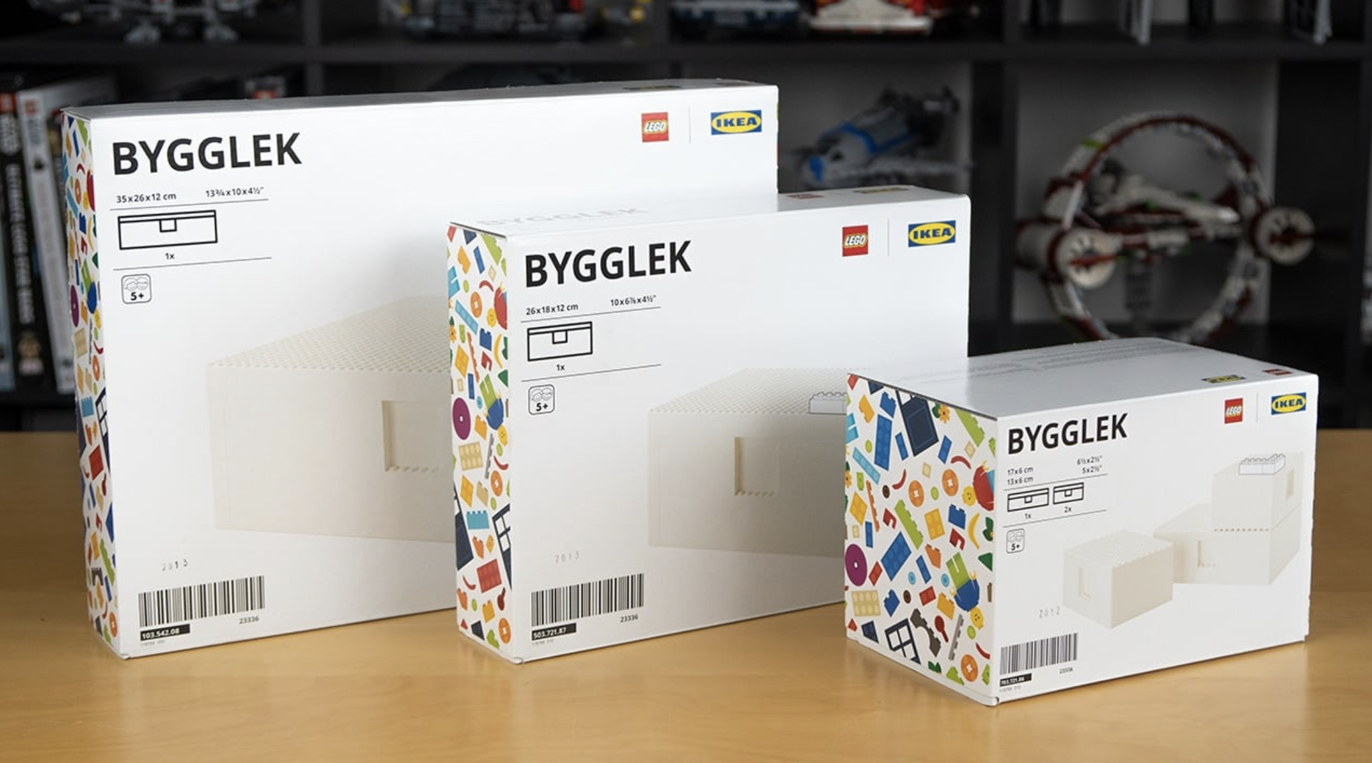

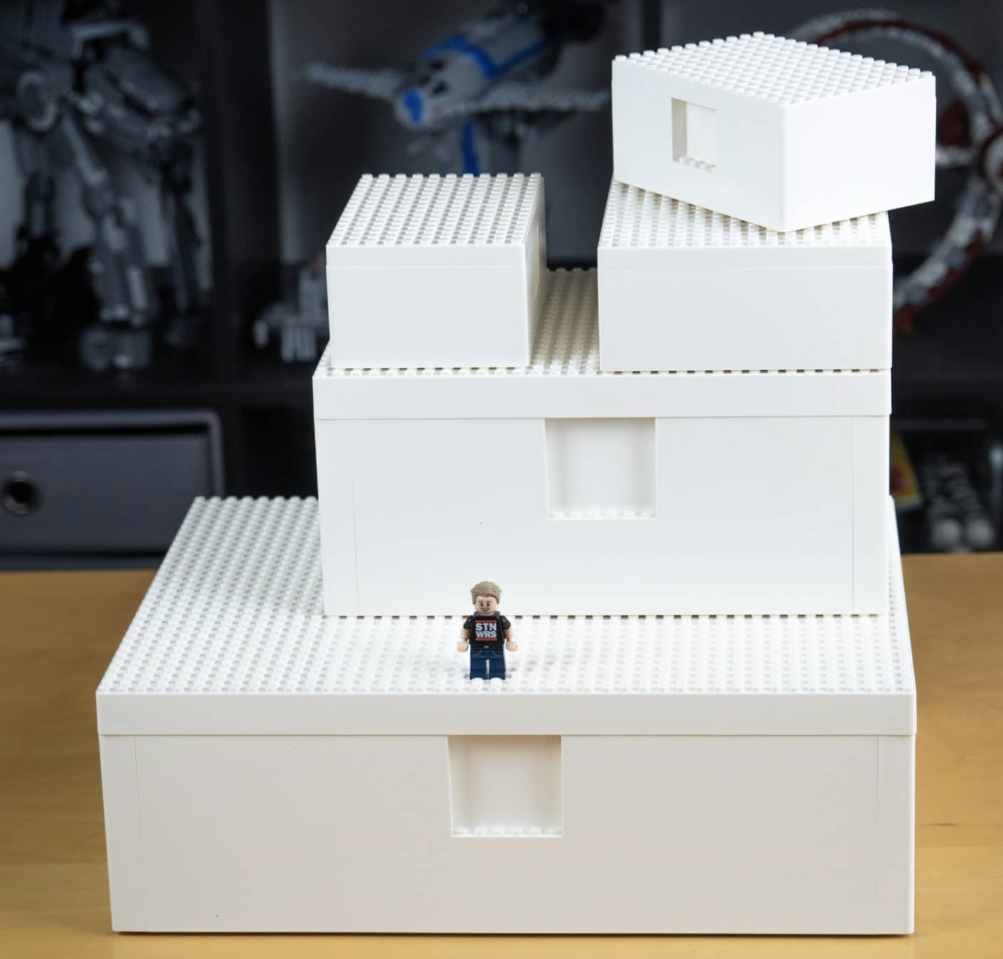

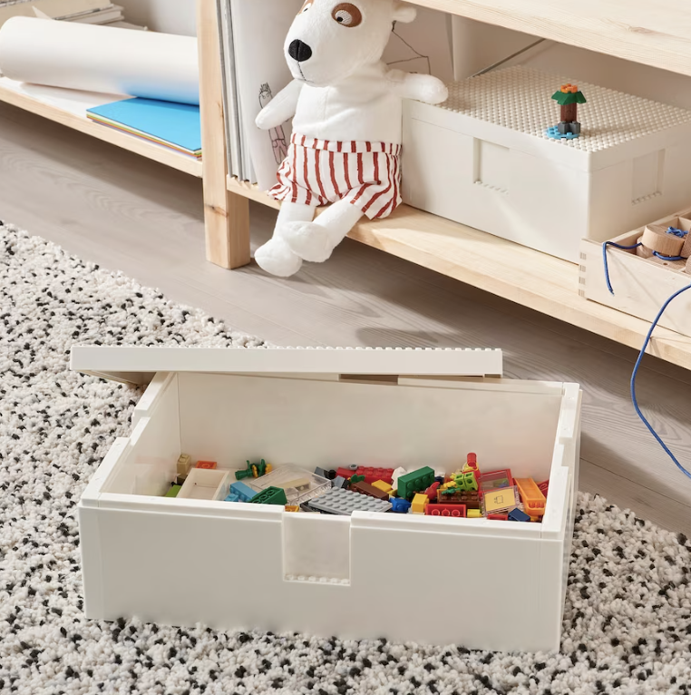
COLLABORATIONS
PART C
-
3. CREATIVE COLLABORATION
EXAMPLES

Slide 61

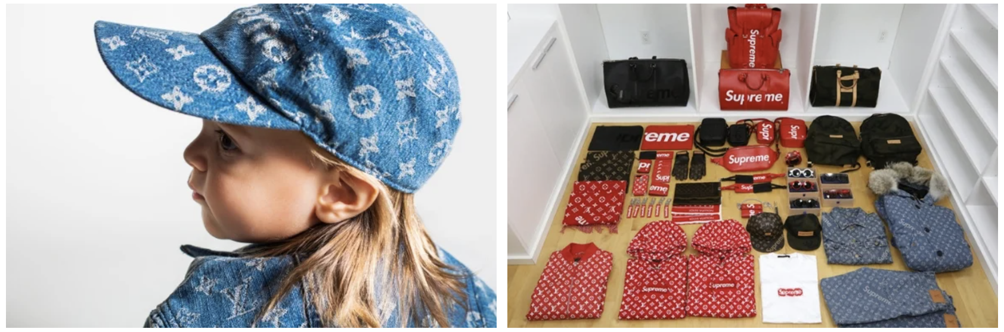
COLLABORATIONS
PART C
-
3. CREATIVE COLLABORATION
EXAMPLES

Slide 62



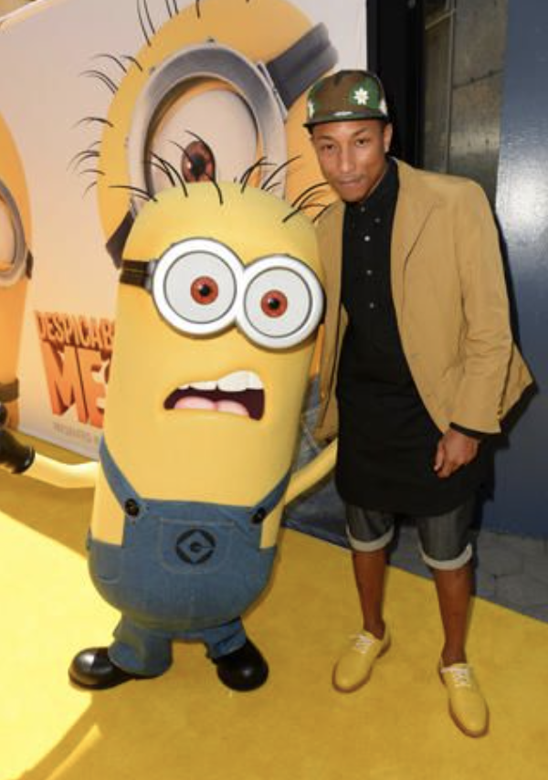
COLLABORATIONS
PART C
Creative Drive vs. Creative Belief
3. CREATIVE COLLABORATION
EXAMPLES

Slide 63


THANK YOU!
KARIM MUSTAGHNI
KARIM@CULTUREDESIGN.ORG

Slide 64
BACKUP

